Slide 1
Software Engineering – Planning & Estimation
Hit Avoidance Protection (HAP)
Team Plan B Instructors
Austin Dionne Jim Kalinowski
Greg Hovagim
Carlos Lazo
Nate Soule

Slide 2
Question A – Problem Constraints
Is the SACC application tightly-constrained or loosely constrained?
What is it about the application that made you choose your answer?
Is this a real-time or non-real-time application? Explain your answer.
The SACC application is loosely constrained
  Design requirements contain very little restrictions
  Requirements offer minimal guidance regarding the solution implementation
This is a real-time application
  Software must respond to incoming sensor data and update CM fast enough to meet given requirements
    Keep CM within 1 degree of current threat

Slide 3
Question B – Safety Critical Requirements
Does the SACC application, as described in the provided spec, have any safety critical requirements for software?
If yes, what are they and why do you think they are safety critical?
If no, why not?
Yes, the SACC is a safety critical application.
Safety Critical Requirements
  Failure to deploy CM → death or serious injury to people

Slide 4
Question C – Project Life-Cycle
Based on the life-cycles talked about in class, what life-cycle do you think is appropriate for the development of the SACC?
Why? What are the reasons for not using the other life-cycles?
Appropriate life cycle for SACC: Iterative
System modeled iteratively in order to:
  Allows for upfront planning (UML, etc.)
  Combination of spiral’s ability to test system components “as you go”
  “Build a little, test a little…”
Did not use Waterfall approach
  Re-evaluation of requirements is not in model (one-way progression)
  Complete requirements of each phase before the next phase begins
Did not use Spiral approach
  Build all subcomponents separately before integration can occur (little testing)

Slide 5
Question D – Software Licenses
What software licenses do you need to consider when developing the SACC?
Visual Studio 2005 Integrated Development Environment (IDE)
  Standard Template Library (STL) will be used
All other code will be original and created by Team Plan B

Slide 6
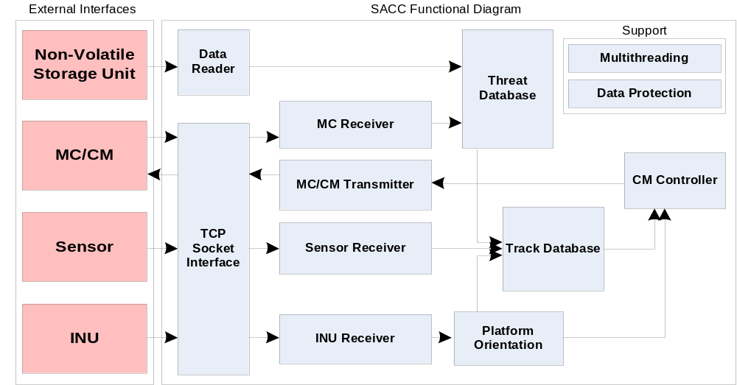
Question E – Design Estimate
In the estimate for item 1 above, how much design did you have to develop in order to generate the estimate?

Slide 7
Question E – Design Estimate (cont)
What happens to your estimate if your design “decisions” don’t work out?
Are these decisions documented as risks?
What impact do these risks have on the project?
If the design “decisions” don’t work →
  Need for redesign would increase cost and time needed to see project to completion
Yes, possible design changes are documented as risks (see XLS)
Impact of risks:
  Cost of mitigation needs to be factored into program budget
  Risks need to be actively monitored and ideally avoided

Slide 8

Question F – High-Level “Functions”
Data Reader
Reads threat wave forms and jam codes from NVSU into Threat DB
Can handle CSV, XML, and Binary formats

Slide 9
Question F – High-Level “Functions”
Threat Database
Stores info about threats loaded from Data Reader or received by MC

Slide 10
Question F – High-Level “Functions”
TCP Socket Interface
Provide an interface for creating and maintaining TCP socket connections

Slide 11
Question F – High-Level “Functions”
INU / MC / Sensor Receivers
Create connections to external interfaces using TCP socket interface
Listen for and receive information and process it accordingly

Slide 12
Question F – High-Level “Functions”
MC/CM Transmitter
Transmit messages related to CM control and unknown threats

Slide 13
Question F – High-Level “Functions”
Platform Orientation
Maintains angular orientation based on INU data and interpolation

Slide 14
Question F – High-Level “Functions”
Track Database
Maintain prioritized list of active threat information seen in environment

Slide 15
Question F – High-Level “Functions”
CM Controller
Directs CM at the highest priority threat ~ system critical component !

Slide 16
Question F – High-Level “Functions”
Multithreading & Data Protection
Allows different logical paths to occur simultaneously
Support needed to protect shared data structures (prevent collisions)

Slide 17

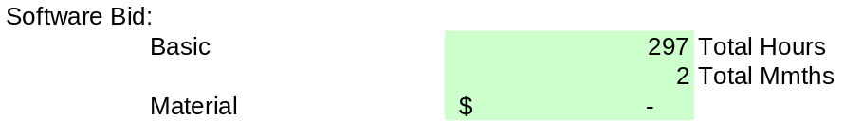
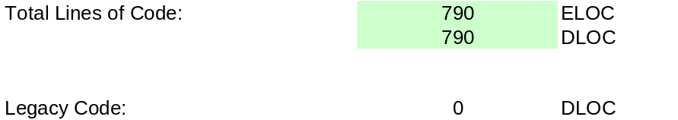
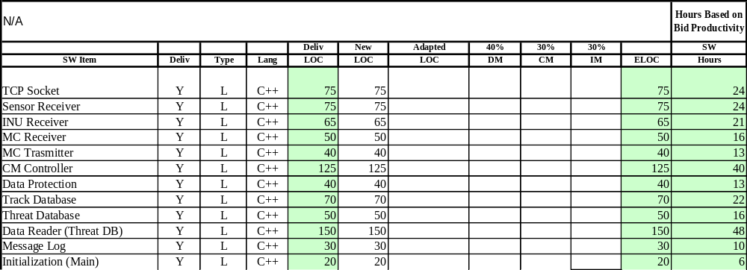
Proposed Design Estimate

Slide 18
¿QUESTIONS?

